Slide 1
QUIZ 2
QUIZ-2: Fill in the answer to the question in the PPT
- Deadline : 2018-04-20 12:00 pm
- File name : [Graphics Quiz-2][your_student ID][your name].pptx
- email : kiun91@hotmail.com
- email subject : [Graphics Quiz-2][your student ID] [your name]

Slide 2
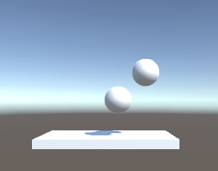
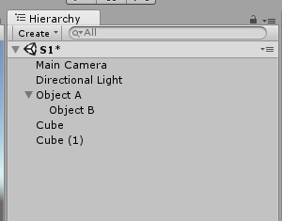
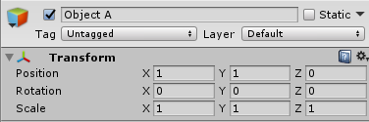

01. Unity Coordinates
Q1. Explain the differences between local coordinates and global coordinates.
Q2. In the following figure, what is the local and global coordinates of object B?
A
B

Slide 3
01. Unity Coordinates
Q3. Using the Debug.Log script, write a script that determines whether the local and global coordinates of the GameObject without the parent are the same.
(Result Text : Same / Not Same)

Slide 4
02. Movement
Q4. Write code that changes the position of the object executing the script by 1 in the X direction and 1 in the Y direction.
Q5. Explain the differences of following scripts
transform.Translate (Vector3.forward) ;
rigidbody.AddForce (Vector3.forward) ;

Slide 5
03. Degree of Arc
Q6. Write code that calculates the angle between the mouse position and the object executing the script.
07. Write code that rotate the angle of the object executing the script by 45 degree.

Slide 6
04. Prefab
Q8. Describe the advantages and application areas of prefab
Q9. Describe the procedure for creating a prefab.
Q10. Write the code that creates the prefab object in an position (0, 0, 0) and destroys it after 5 seconds.

Slide 7
05. Joints
Q11. Provide an experimental method to explain the difference between the distance joint and the spring joint.
Q12. Provide an experimental method to explain the difference between the fixed joint and the relative joint.

Slide 8
06. Effector 2D
Q13. Describe the application area of platform effector 2D.
Q14. Describe the algorithm for implementing Point Effect 2D in Script

